Slide 1
Statistics Analysis- ST1002
Estimation

Slide 2

Dilbert

Slide 3
Assignments
2 assignments worth 15%
Assignment 1 5%
Assignment 2 10%
A number of labs worth another 15%

Slide 4
Problem
Population of 20,000 households
Want to estimate annual income
What do we do?
Have not the money or resources to ask everyone
Take a sample of 100 households
Why 100 !!!!!!!!!!
Good question

Slide 5
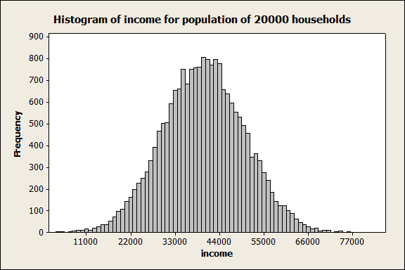
Population Distribution
Mean = €40,044, SD= €10,072 True and unknown mean indicated by µ and
SD indicated by σ

Slide 6
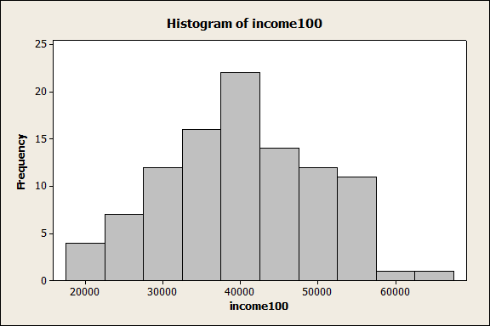
Sample size of 100
Mean = €40,217 SD= €9,920

Slide 7
And again and again ….
sample | Means | SD
1 | €40,374 | €10,676
2 | €38,388 | €9,225
3 | €39,196 | €10,116
4 | €39,607 | €10,139
5 | €40,406 | €8,736
6 | €39,040 | €9,869
7 | €38,635 | €11,046
8 | €39,401 | €10,926
9 | €39,697 | €9,846
10 | €39,858 | €10,055

Slide 8
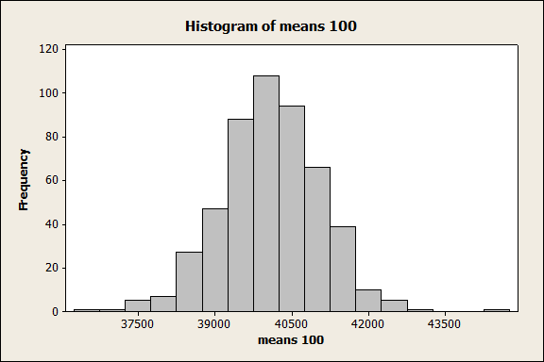
And still in never never land
Sampling distribution of the means

Slide 9
Some facts ….
Sampling distribution of the means are normally distributed for a lot of situations
Much tighter than the population distribution
Given that the sample is taken properly, mean of the sampling means should equal population mean µ
SD of the sample means distribution = (called the standard error of the mean (SE))
n= sample size and σ is the population standard deviation(which of course we do not know)

Slide 10
And again …..
How do we calculate
We use the sample SD(9,920) to estimate σ
Let us call this SE – standard deviation of the distribution of sample means
Theory tells 95% of all sample means lie in this

Slide 11
Why 1.96???
Back to the Normal distribution
If we look up 1.96 in the table we get 0.975
1-.975 or .025 or 2.5% of the area above 1.96
Additionally there is 2.5% of the area below
-1.96

Slide 12
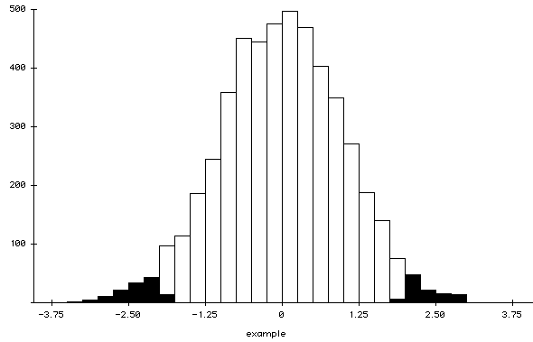
And yet another graph

Slide 13
Let us come down to earth now
We take 1 sample and we want to say something about true average µ
We take a single sample and calculate mean, there is a 95% chance that it will be within a distance of 1.96* SE of µ
We now consider the distance of µ from our sample mean
The interval ±1.96*SE includes µ 95% of the time

Slide 14
And some more facts ….
Sample mean = €40,217; SD = €9,920 ; n=100
95% confidence interval =
95% confident that the population mean lies in this interval

Slide 15
What does the 95% really mean?
Suppose we drew 100 samples and calculate 100 CI’s.
95% of them would contain the population mean
5% would not.
Of course we have no idea which intervals contain the population mean

Slide 16
How about a 99% CI
What is the magic number?
1% divided between the two tails
.5% = .005
To look up the table backwards we need to calculate 1-.005 = .995
2.55 to 2.61
Traditionally taken as 2.58

Slide 17
Result
99% confidence interval.
What do you notice?

Slide 18
Distribution of data
Sample data does not have to be normally distributed
As the sample size gets bigger, sampling distribution of the mean will be more normal
Central limit theorem
n> 30 usually fine
Sampling distribution of other statistics exist
Simple random sampling

Slide 19
Population size N
Does not figure here at all
Be careful if it is small it needs to be considered
n/N >0 .1 ask somebody what to do.
There is a another term involved

Slide 20
Major important issue
How do we select the 100 households from the 20,000 household
Incredibly important
We will cover this later

Slide 21
What happens for proportions?
Same idea.
We collect a sample and calculate an estimate and an interval estimate like before.
We need to know how to calculate the SE(proportion)

Slide 22
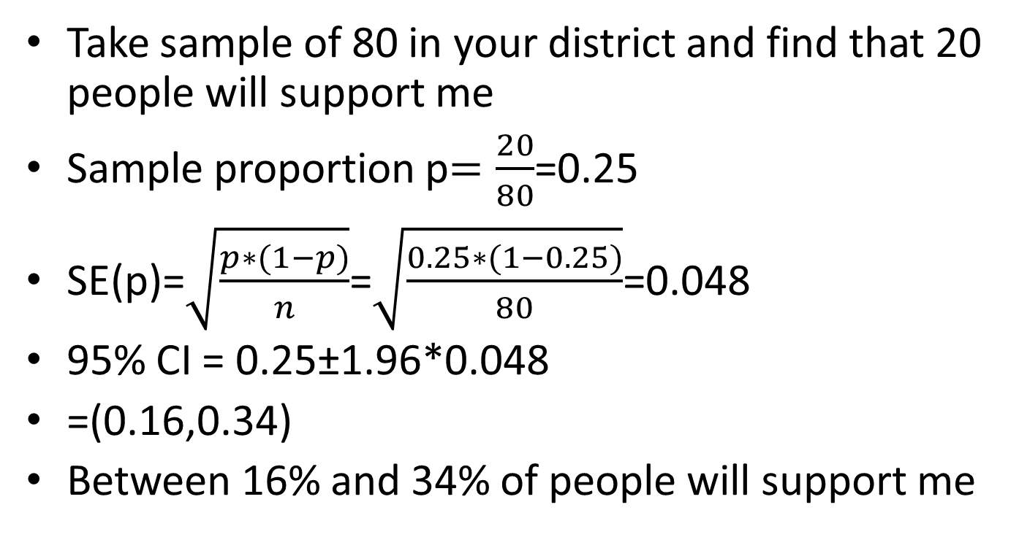
Example with proportions
Take sample of 80 in your district and find that 20 people will support me
Sample proportion p$=\frac{20}{80}$=0.25
SE(p)=$\sqrt{\frac{p∗(1−p)}{n}}$=$\sqrt{\frac{0.25∗(1−0.25)}{80}}$=0.048
95% CI = 0.25±1.96*0.048
=(0.16,0.34)
Between 16% and 34% of people will support me

Slide 23
Just one consideration
The above is an approximation
n*p*(1-p) > 5 for it to work
In our example n=80, p=0.25
n*p*(1-p)=80*0.25*0.75=15
So we are fine.

Slide 24
Important message
Concept of an interval estimate
Applicable anywhere where we calculate a statistic based on a sample
Sampling distribution for a statistic
We have seen how to calculate the SE for a mean
We will see many more applications in future
Margin of error
Measure of uncertainty
Width of interval

Slide 25
Websites
http://www.youtube.com/watch?v=jbkSRLYSojo

